Slide 1
Upcoming Assignments
Monday – Self Checks 1,2,3, 10
Tuesday – Self Checks 5, 6, 7, 8, 9
Practice-It is a bit thin for this chapter, not all problems are implemented. Submit answers using , notepad

Slide 2
9.1 Inheritance
Interlake High School
AP Computer Science

Slide 3
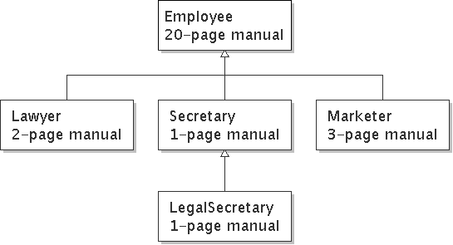
Law firm employee analogy
common rules: hours, vacation, benefits, regulations ...
all employees attend a common orientation to learn general company rules
each employee receives a 20-page manual of common rules
each subdivision also has specific rules:
employee receives a smaller (1-3 page) manual of these rules
smaller manual adds some new rules and also changes some rules from the large manual

Slide 4
Separating behavior
Why not just have a 22 page Lawyer manual, a 21-page Secretary manual, a 23-page Marketer manual, etc.?
Some advantages of the separate manuals:
maintenance: Only one update if a common rule changes.
locality: Quick discovery of all rules specific to lawyers.
Some key ideas from this example:
General rules are useful (the 20-page manual).
Specific rules that may override general ones are also useful.

Slide 5
Employee regulations
Consider the following employee regulations:
Employees work 40 hours / week.
Employees make $40,000 per year, except legal secretaries who make $5,000 extra per year ($45,000 total), and marketers who make $10,000 extra per year ($50,000 total).
Employees have 2 weeks of paid vacation leave per year, except lawyers who get an extra week (a total of 3).
Employees should use a yellow form to apply for leave, except for lawyers who use a pink form.
Each type of employee has some unique behavior:
Lawyers know how to sue.
Marketers know how to advertise.
Secretaries know how to make schedule.
Legal secretaries know how to prepare legal documents.

Slide 6
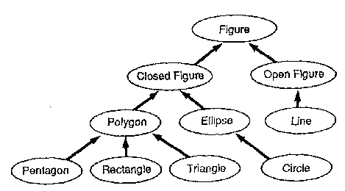
Is-a relationships, hierarchies
is-a relationship: A hierarchical connection where one category can be treated as a specialized version of another.
every marketer is an employee
every legal secretary is a secretary
inheritance hierarchy: A set of classes connected by is-a relationships that can share common code.

Slide 7
An Employee class
// A class to represent employees in general (20-page manual).
public class Employee {
public int getHours() {
return 40; // works 40 hours / week
}
public double getSalary() {
return 40000.0; // $40,000.00 / year
}
public int getVacationDays() {
return 10; // 2 weeks' paid vacation
}
public String getVacationForm() {
return "yellow"; // use the yellow form
}
}

Slide 8
Redundant Secretary class
// A redundant class to represent secretaries.
public class Secretary {
public int getHours() {
return 40; // works 40 hours / week
}
public double getSalary() {
return 40000.0; // $40,000.00 / year
}
public int getVacationDays() {
return 10; // 2 weeks' paid vacation
}
public String getVacationForm() {
return "yellow"; // use the yellow form
}
public void makeSchedule(String text) {
System.out.println("Taking dictation of text: " + text);
}
}

Slide 9
Desire for code-sharing
makeSchedule is the only unique behavior in Secretary.
We'd like to be able to say:
// A class to represent secretaries.
public class Secretary {
copy all the contents from the Employee class;
public void makeSchedule(String text) {
System.out.println("Taking dictation of text: " + text);
}
}

Slide 10
Inheritance
inheritance: A way to form new classes based on existing classes, taking on their attributes/behavior.
a way to group related classes
a way to share code between two or more classes
One class can extend another, absorbing its data/behavior.
superclass: The parent class that is being extended.
subclass: The child class that extends the superclass and inherits its behavior.
Subclass gets a copy of every field and method from superclass (public)

Slide 11
Inheritance syntax
public class name extends superclass {
Example:
public class Secretary extends Employee {
...
}
By extending Employee, each Secretary object now:
receives a getHours, getSalary, getVacationDays, and getVacationForm method automatically
can be treated as an Employee by client code (seen later)

Slide 12
Improved Secretary code
// A class to represent secretaries.
public class Secretary extends Employee {
public void makeSchedule(String text) {
System.out.println("Taking dictation of text: " + text);
}
}
Now we only write the parts unique to each type.
Secretary inherits getHours, getSalary, getVacationDays, and getVacationForm methods from Employee.
Secretary adds the makeSchedule method.

Slide 13
Implementing Lawyer
Consider the following lawyer regulations:
Lawyers who get an extra week of paid vacation (a total of 3).
Lawyers use a pink form when applying for vacation leave.
Lawyers have some unique behavior: they know how to sue.
Problem: We want lawyers to inherit most behavior from employee, but we want to replace parts with new behavior.

Slide 14
Overriding methods
override: To write a new version of a method in a subclass that replaces the superclass's version.
No special syntax required to override a superclass method. Just write a new version of it in the subclass.
public class Lawyer extends Employee {
// overrides getVacationForm method in Employee class
public String getVacationForm() {
return "pink";
}
...
}

Slide 15
Lawyer class
// A class to represent lawyers.
public class Lawyer extends Employee {
// overrides getVacationForm from Employee class
public String getVacationForm() {
return "pink";
}
// overrides getVacationDays from Employee class
public int getVacationDays() {
return 15; // 3 weeks vacation
}
public void sue() {
System.out.println("I'll see you in court!");
}
}

Slide 16
Marketer class
// A class to represent marketers.
public class Marketer extends Employee {
public void advertise() {
System.out.println("Act now while supplies last!");
}
public double getSalary() {
return 50000.0; // $50,000.00 / year
}
}

Slide 17
Levels of inheritance
Multiple levels of inheritance in a hierarchy are allowed.
Example: A legal secretary is the same as a regular secretary but makes more money ($45,000) and can file legal briefs.
public class LegalSecretary extends Secretary {
...
}

Slide 18
LegalSecretary class
// A class to represent legal secretaries.
public class LegalSecretary extends Secretary {
public void fileLegalBriefs() {
System.out.println("I could file all day!");
}
public double getSalary() {
return 45000.0; // $45,000.00 / year
}
}

Slide 19
What Is Inherited?
Everything that isn’t private
All the non-private methods in the superclass
All the non-private data in the superclass

Slide 20
More Overrides
To override the parent’s version of the method, just redeclare it in the child class.
The method’s name and signature must exactly match the version in the superclass. If it doesn’t, the superclass version gets called instead.
In our chapter 8 classes, what useful method have we already created overrides for frequently?
Overriding is not overloading.
Overloading is providing multiple signatures for the same method name, thus taking different parameter lists and probably slightly different behavior.
Overriding is replacing the superclass’ method with a different implementation in the subclass.

Slide 21
Upcoming Assignments
Monday – Monday – Self Checks 1,2,3, 10
Tuesday – Self Checks 5, 6, 7, 8, 9
Practice-It is a bit thin for this chapter, not all problems are implemented. Submit answers using notepad

